Slide 1


Covid-Tracker Project
By Yusuf Oguntoyinbo & Zeeshan Khan

Slide 2
Introduction
For this project we was required to develop a web server application using node js express to design the RESTAPI .The RESTAPI should have endpoint to perform following task
Adding data to the Covid collection.
It should also have an separate endpoint for update case, death and date for a given state and country, the updated record should be displayed on the browser
It should show separate endpoint to show total number of cases and deaths for a given state and country
A separate endpoint for deleting a document for given state and country.
it should have an endpoint to display first 20 documents from the covid database for a given date and state
It should have an endpoint to display the states where Cases are more than 1 in a single day
OS information

Slide 3
Project Assumption
For this project there are some assumption we must ensure are in place before we can begin the project.
Correct and Valid data: it is important that we valid the data we will be using and ensure that the data is accurate.
Git user account: All member of the team must ensure that they are registered and have access to the repository to ensure that we can simultaneously work on the project.
Software Installation: As a team we must ensure that we have all the required software required to develop and manage our web server application

Slide 4
Design Methodology
For this project we have decided to take the Agile approach. This design methodology allows us to Focus on the code rather than the design, it is important for this application that we put an emphasis on functionality rather than design, and Agile allows us to do that in the most effective way.

Slide 5
Code – Covidinfo.js

Slide 6
Update - HTML

Slide 7
View Totals – HTML

Slide 8
Find 20 - HTML

Slide 9
Find more than One – HTML

Slide 10
Delete data

Slide 11
Add data - HTML

Slide 12
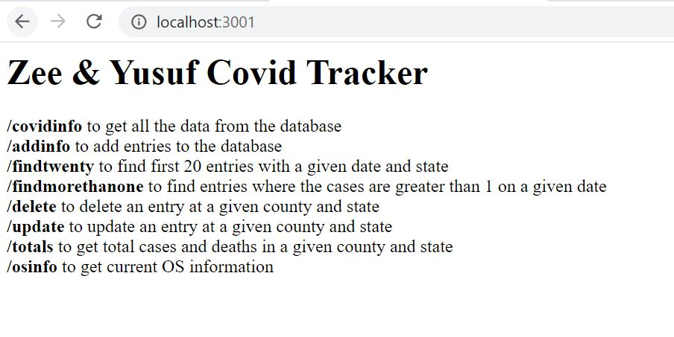
Homepage

Slide 13
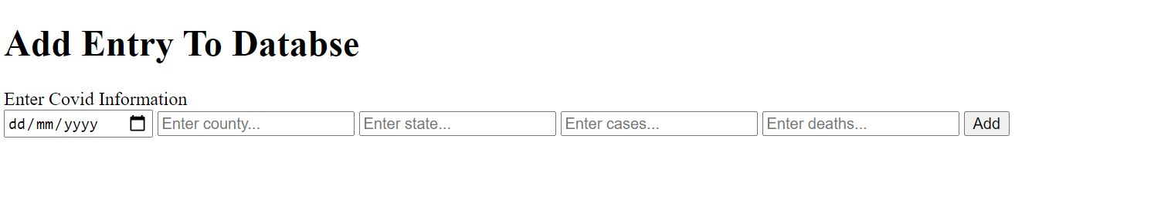
Add New Entries

Slide 14
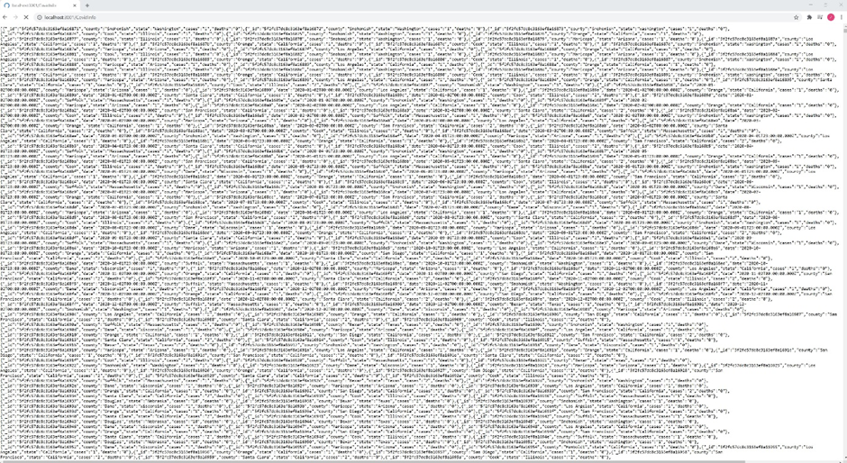
All Data

Slide 15
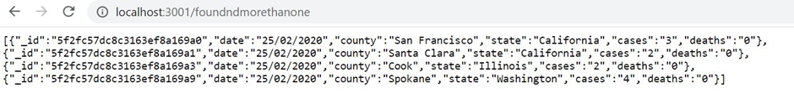
Cases More Than 1

Slide 16
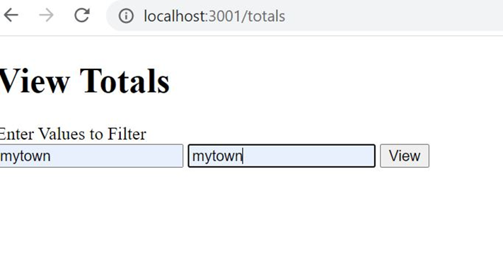
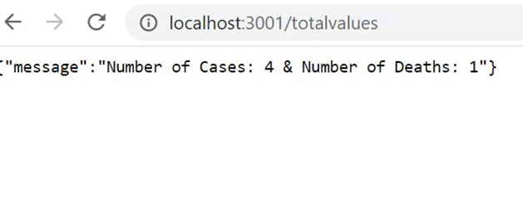
View Total & Total Results

Slide 17
Working Demo
By Zeeshan Khan

Slide 18
Thank you

